Slide 1


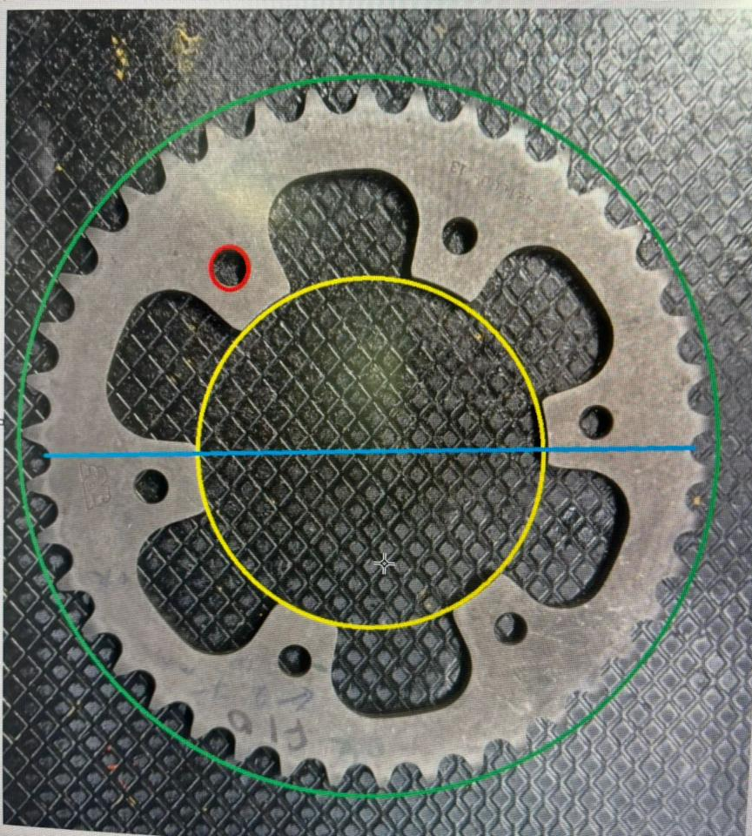
903 PART CAMERA INSPECTION
MAJOR CHECKING PARAMETER:
Hole diameter- Red
Bore diameter- Yellow
Outer dia - Green
MOP - Bule
Teeth thickness
Teeth count
Flatness
Vision inspection system required for dimensional measurement of the rear sprocket with an accuracy of 20-30 microns.
COMPONENT IMAGE

Slide 2
FINAL INSPECTION CHECK LIST
Part Name |  | Rear Sprocket
Part Number |  | 903
Customer Part No. |  | 1100701
Customer Name |  | REML
# | Parameter | Spec | Tolerance | Check method
1 | MOP | 222.29 ~ 222.59 | 0.3 | Dial Type MOP Gauge
2 | Outer Ø | 219.33 ~ 219.83 | 0.5 | Micrometer
3 | Bore Ø | 111.00 ~ 111.50 | 0.5 | Bore Dial
4 | Root Ø | 201.97 ~ 202.27 | 0.3 | CMM
5 | Thickness | 5.6 ~ 6.00 | 0.4 | Micrometer
6 | Mount Hole Ø | 10.50 ~ 10.70 | 0.2 | Inside Caliper / Vernier caliper
7 | PCD | Ø 143 |  | CMM
8 | Mouting Hole Position w.r.t Bore | 0.25 w.r.t A and B | 0.25 | CMM
9 | Face out | 0.2 Max w.r.t A and B | 0.2 | Bench centre, Mandrel with Dial Indicator
10 | Flatness | 0.4 Max | 0.4 | CMM
11 | Root Runout | 0.2 Max w.r.t A and B | 0.2 | Bench centre, Mandrel with Dial Indicator
12 | No. of Teeth | 42 | - | Counting (Manual)
13 | Naming | Part Traceability Customer Part Number |  | Visual

